Slide 1
Formulating 2D Dirichlet Boundary Conditions for FDFD

Slide 2
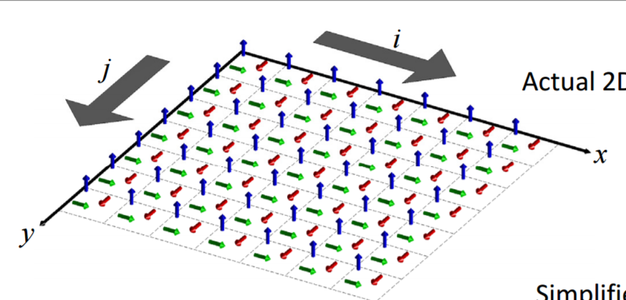
For the Yee’s lattice, we see that the Dirichlet boundary condition has to be a combination of PECs and PMCs

